Slide 1
PREFERENTIAL CONCENTRATION OF PARTICLES BY TURBULENCE
Amir A. Mofakham and Goodarz Ahmadi
Department of Mechanical and Aeronautical Engineering
Clarkson University, Potsdam, NY
John McLaughlin
Department of Chemical and Biomolecular Engineering
Clarkson University, Potsdam, NY
Aug. 2018

Slide 2
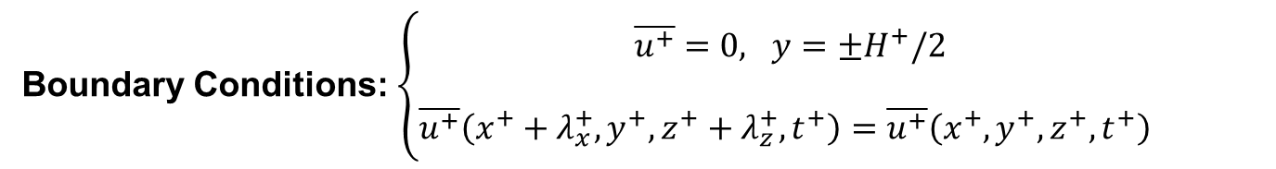

Geometry and Boundary Conditions
Boundary Conditions: $\left\{\begin{aligned}\overline{u^{+}}=0, y=±H^{+}/2 \\ \\ \overline{u^{+}}\left(x^{+}+λ_{x}^{+},y^{+},z^{+}+λ_{z}^{+},t^{+}\right)=\overline{u^{+}}\left(x^{+},y^{+},z^{+},t^{+}\right) \end{aligned}\right.$
Upper Wall
Gridding
$$nx=64, ny=65, nz=64$$
Chebyshev series
Mean Flow
Lower Wall
Center Line

Slide 3
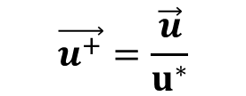

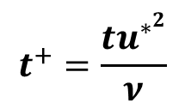
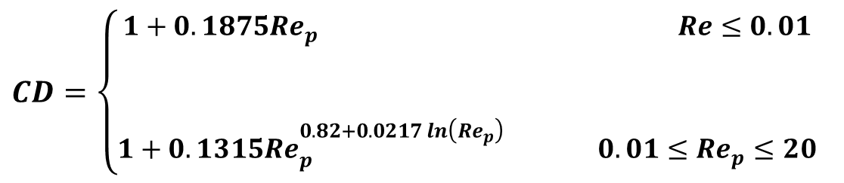
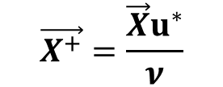
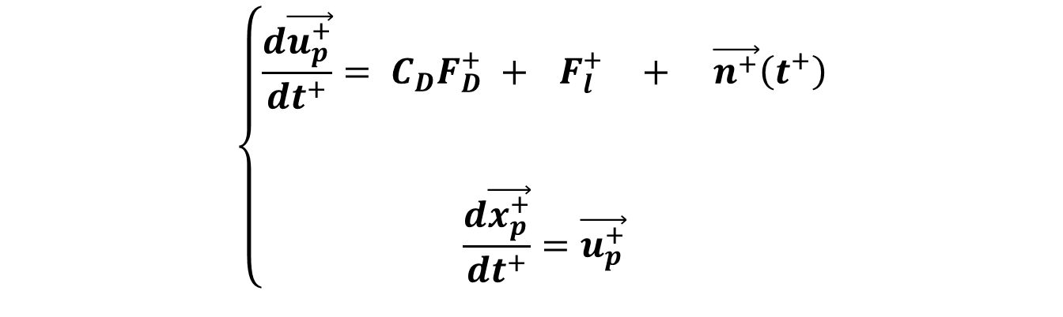

Eulerian-Lagrangian Method
$$\vec{X^{+}}=\frac{\vec{X}u^{∗}}{ν}$$
$$t^{+}=\frac{tu^{∗^{2}}}{ν}$$
$$\vec{u^{+}}=\frac{\vec{u}}{u^{∗}}$$
Wall units:
$$\left\{\begin{aligned}\frac{d\vec{u_{p}^{+}}}{dt^{+}}= C_{D}F_{D}^{+} +{ F}_{l}^{+} + \vec{n^{+}}\left(t^{+}\right) \\ \\ \\ \frac{d\vec{x_{p}^{+}}}{dt^{+}}=\vec{u_{p}^{+}}\end{aligned}\right.$$
Drag force
Lift Force
Brownian motion
Particle equation of motion:
$$CD=\left\{\begin{aligned}1+0.1875Re_{p} Re≤0.01 \\ \\ \\ 1+0.1315Re_{p}^{0.82+0.0217\ln\left(Re_{p}\right) } 0.01≤Re_{p}≤20\end{aligned}\right.$$
Drag coefficient:

Slide 4
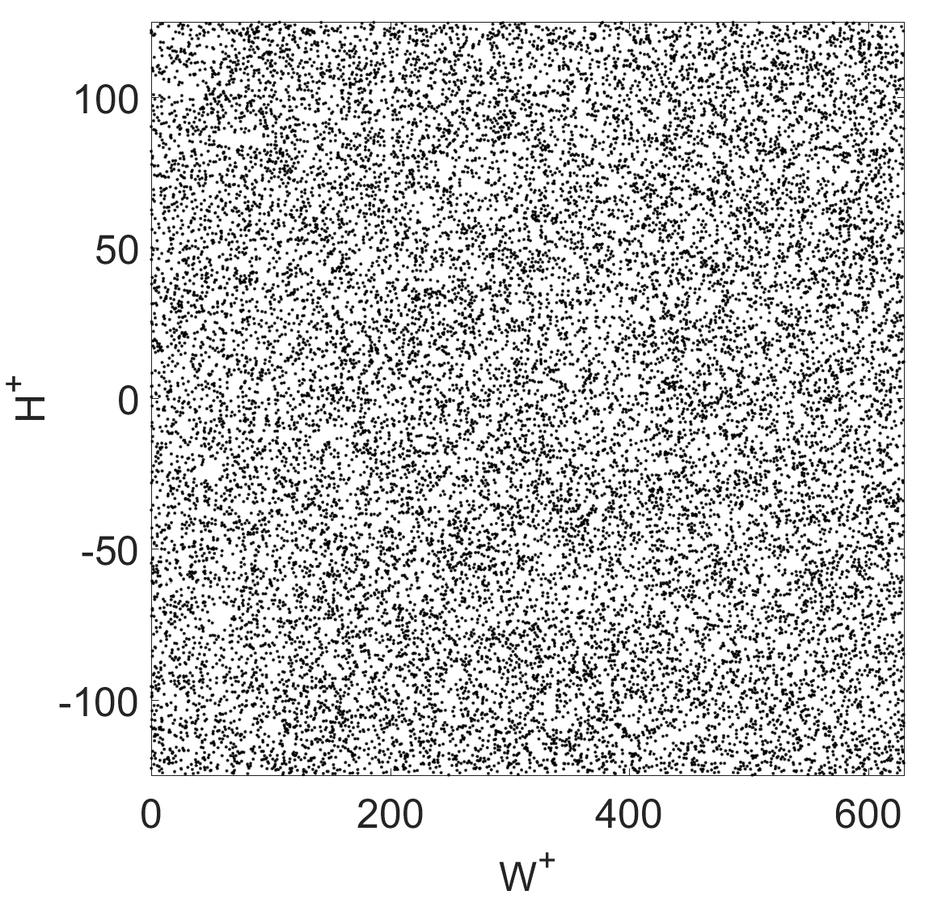
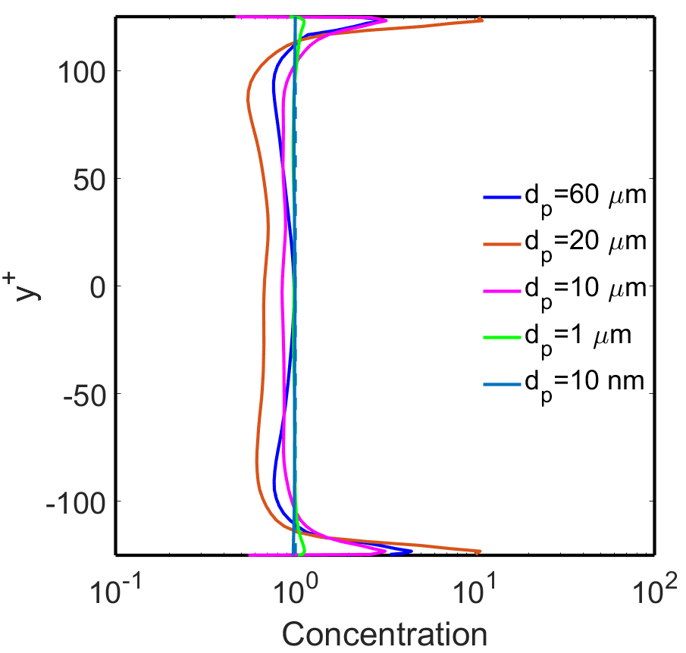
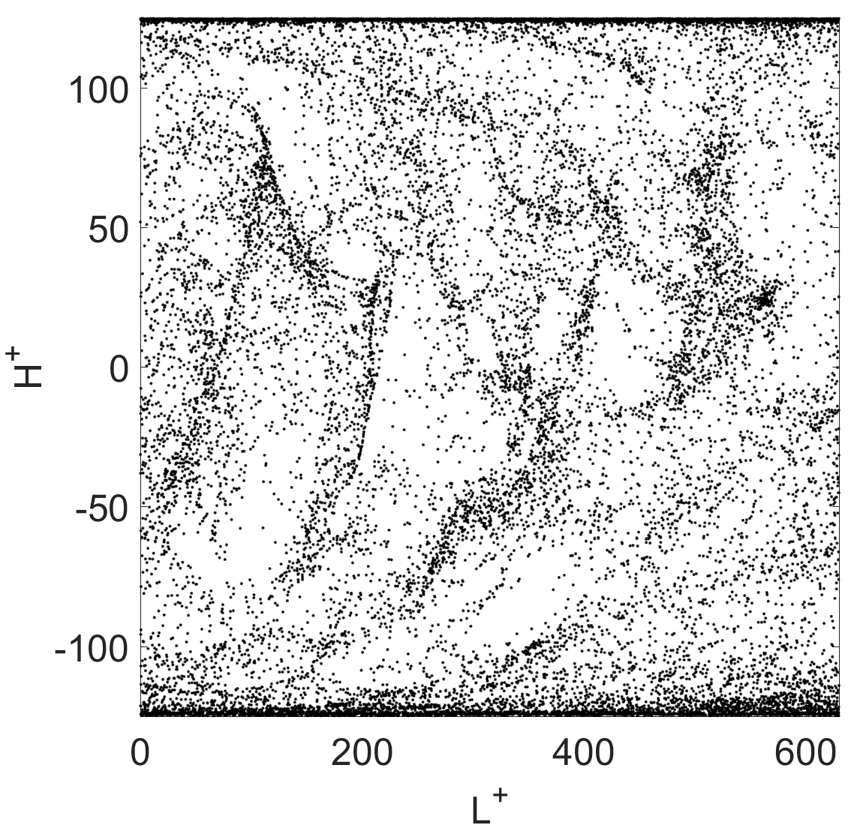


Concentration Profiles
$$d_{p}=10 nm$$
$$d_{p}=20 μm$$

Slide 5
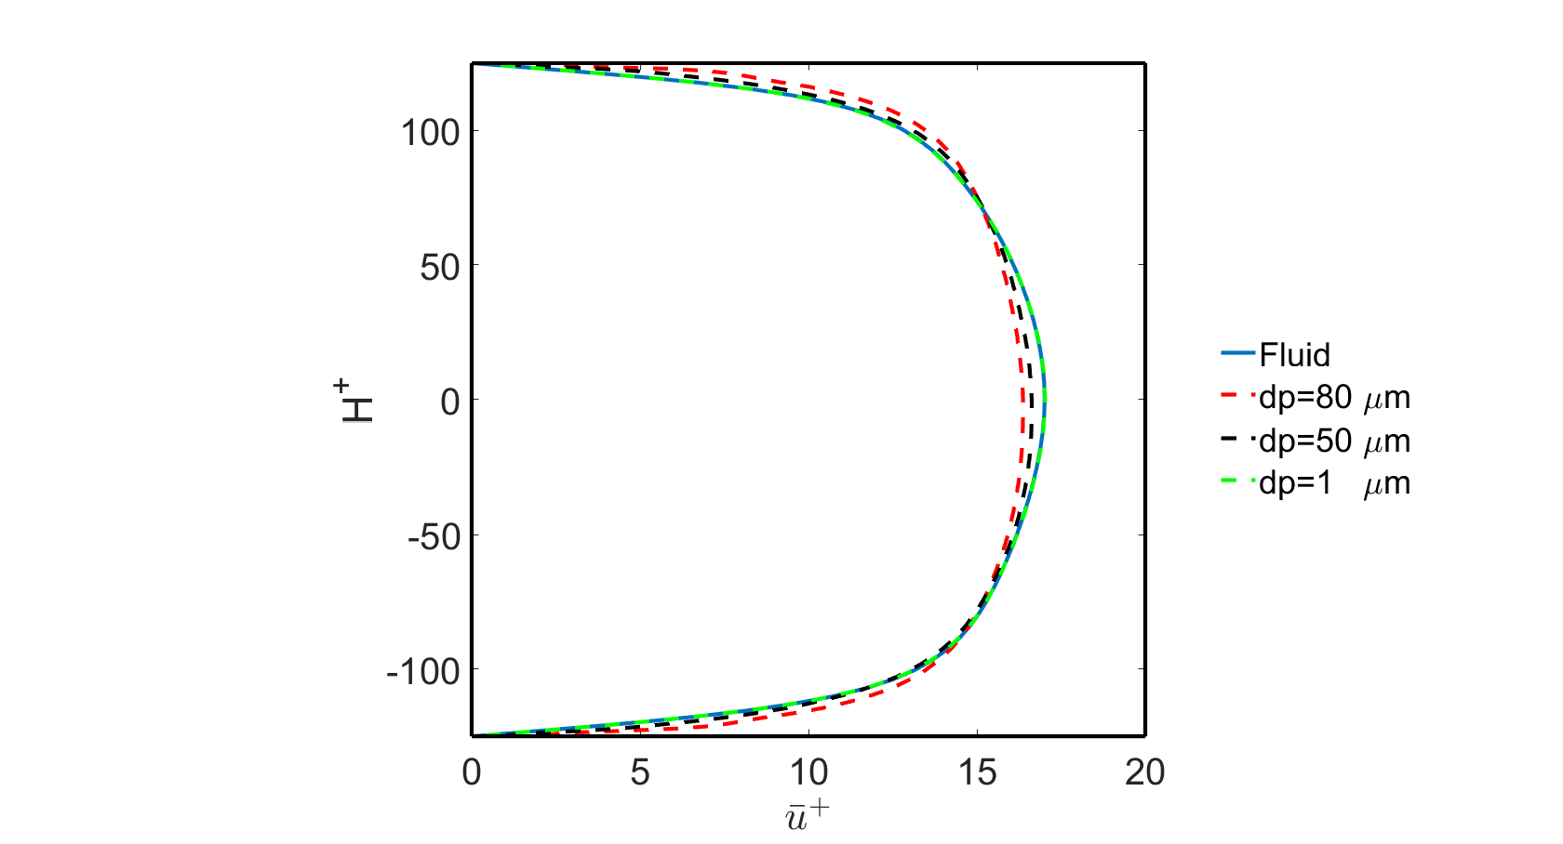
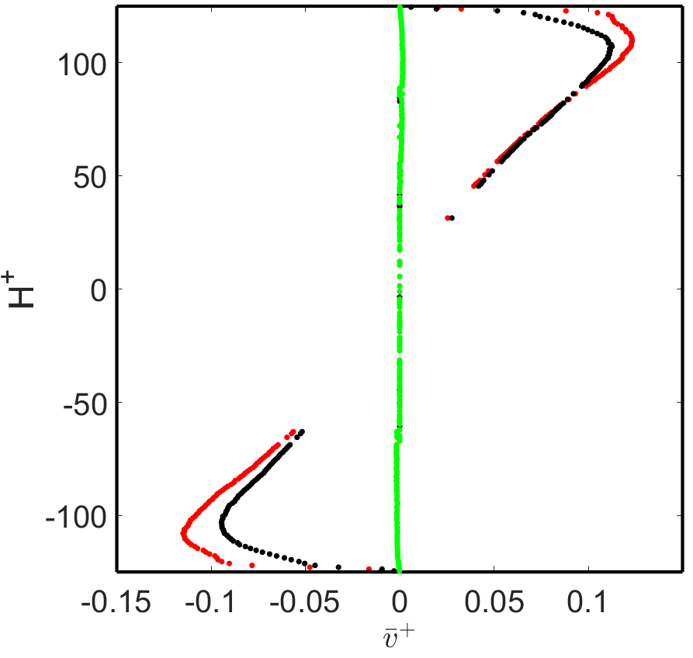
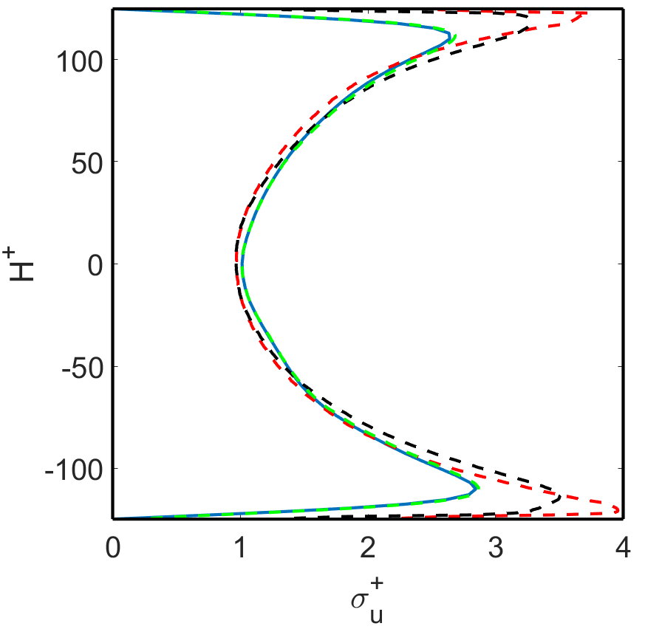
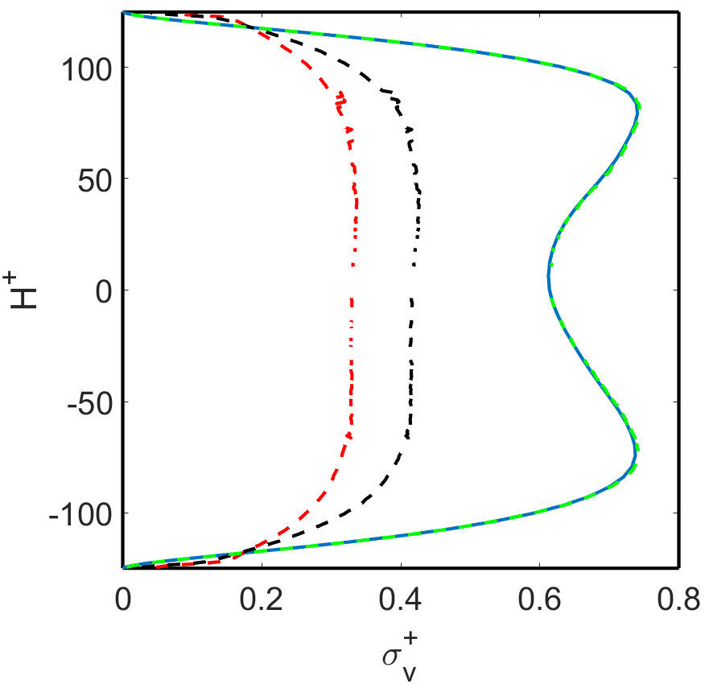
Velocity Profiles

Slide 6
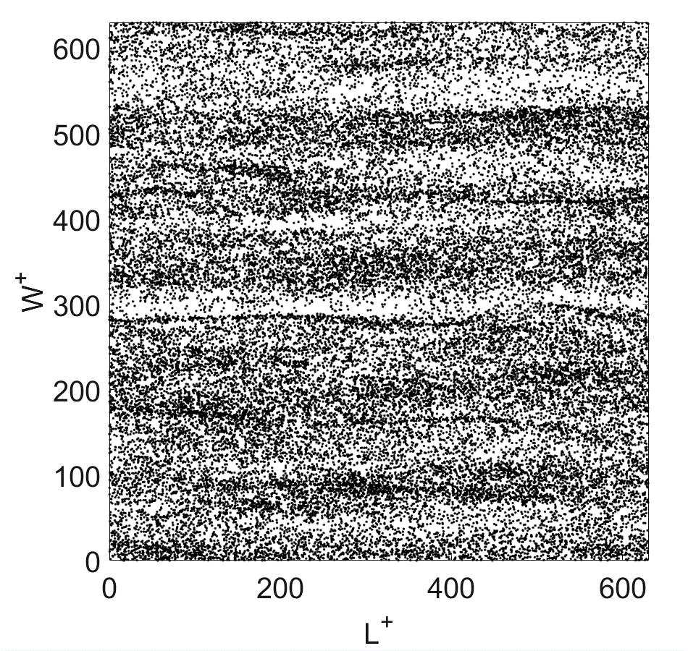
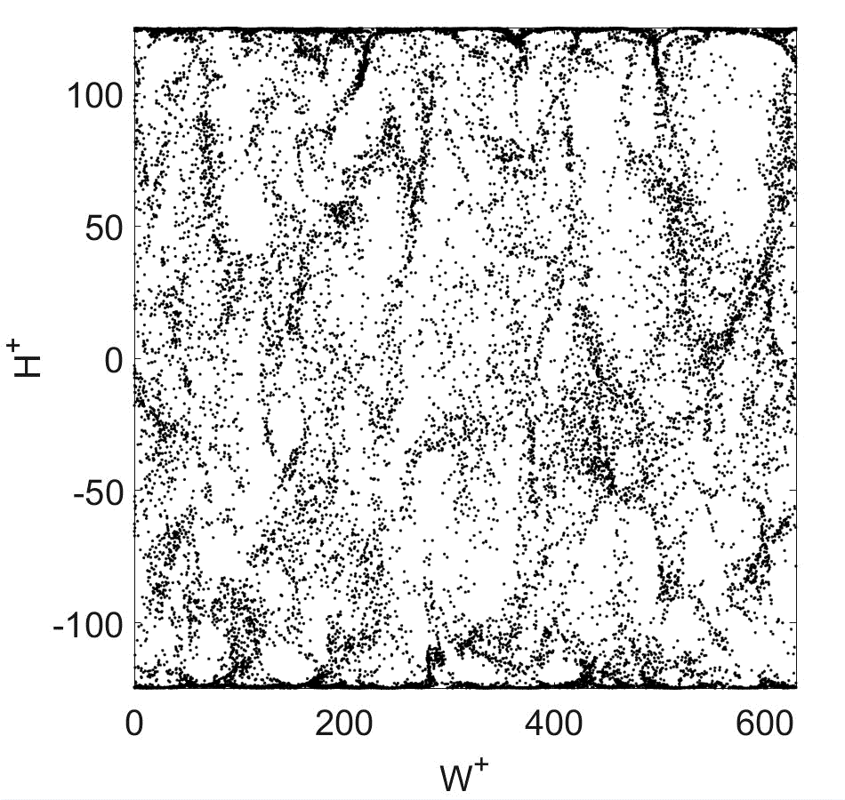
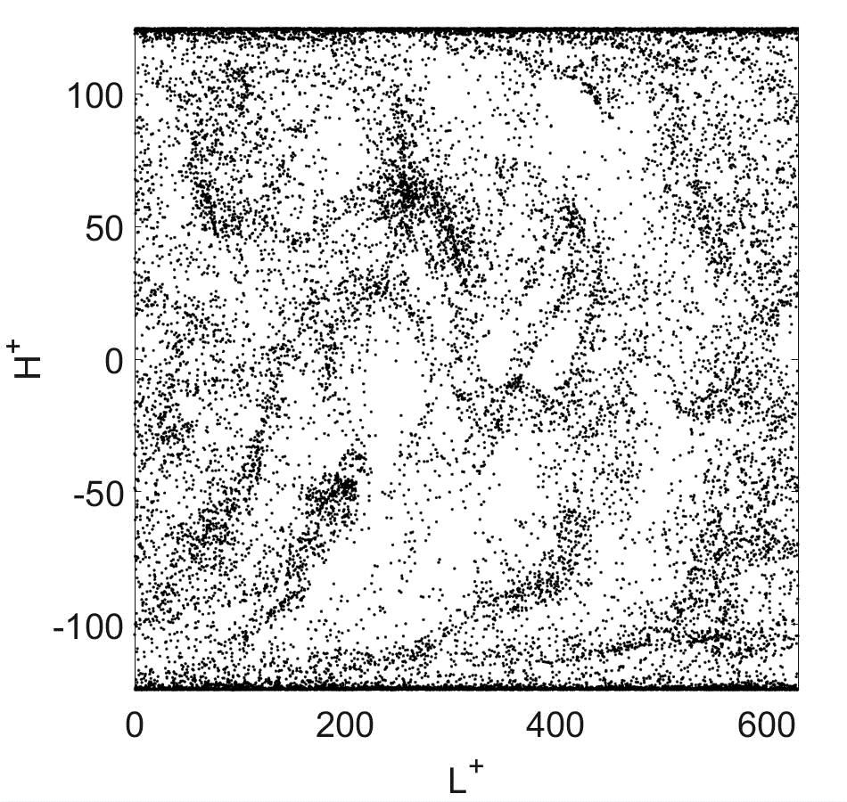
Preferential Concentration of 20 µm particles
Normalwise direction
Streamwise direction
Spanwise direction

Slide 7
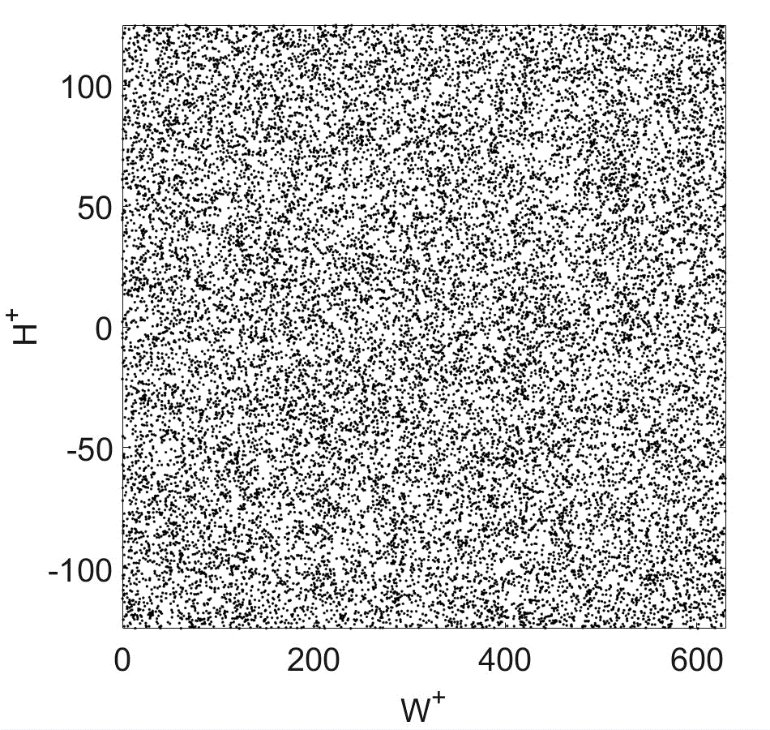
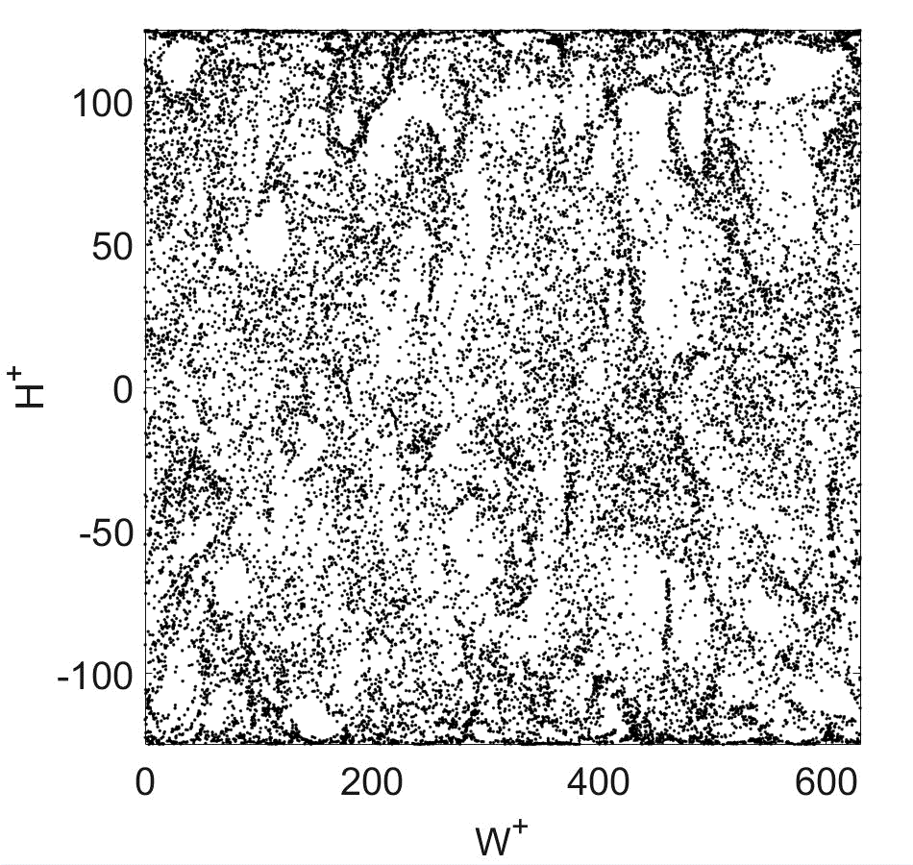
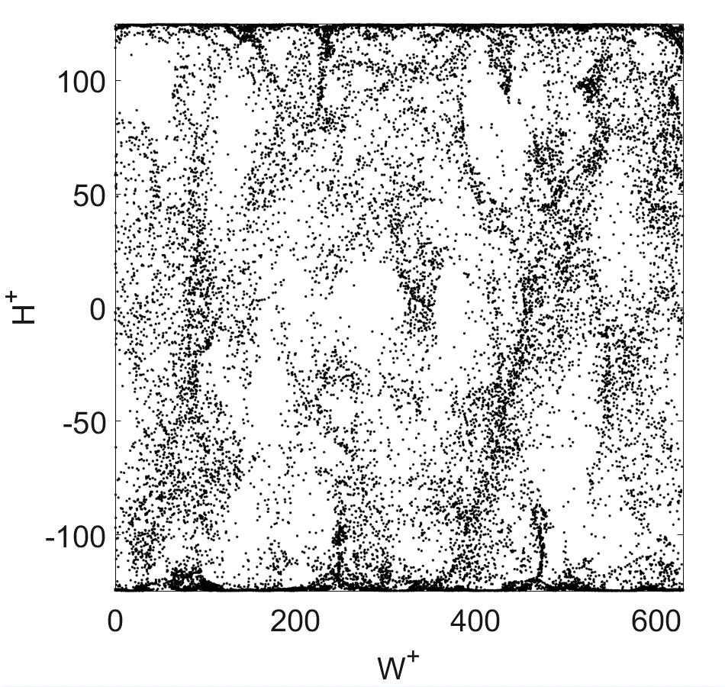
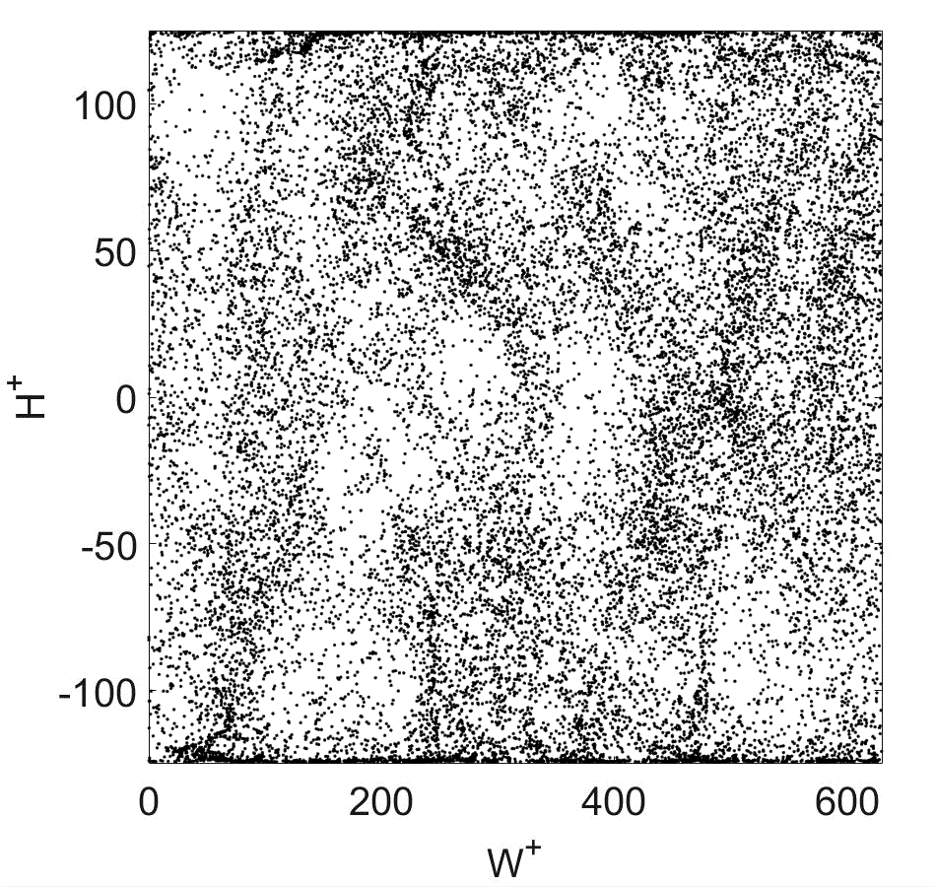
Streamwise Direction
dp=1 µm
dp=10 µm
dp=30 µm
dp=60 µm

Slide 8
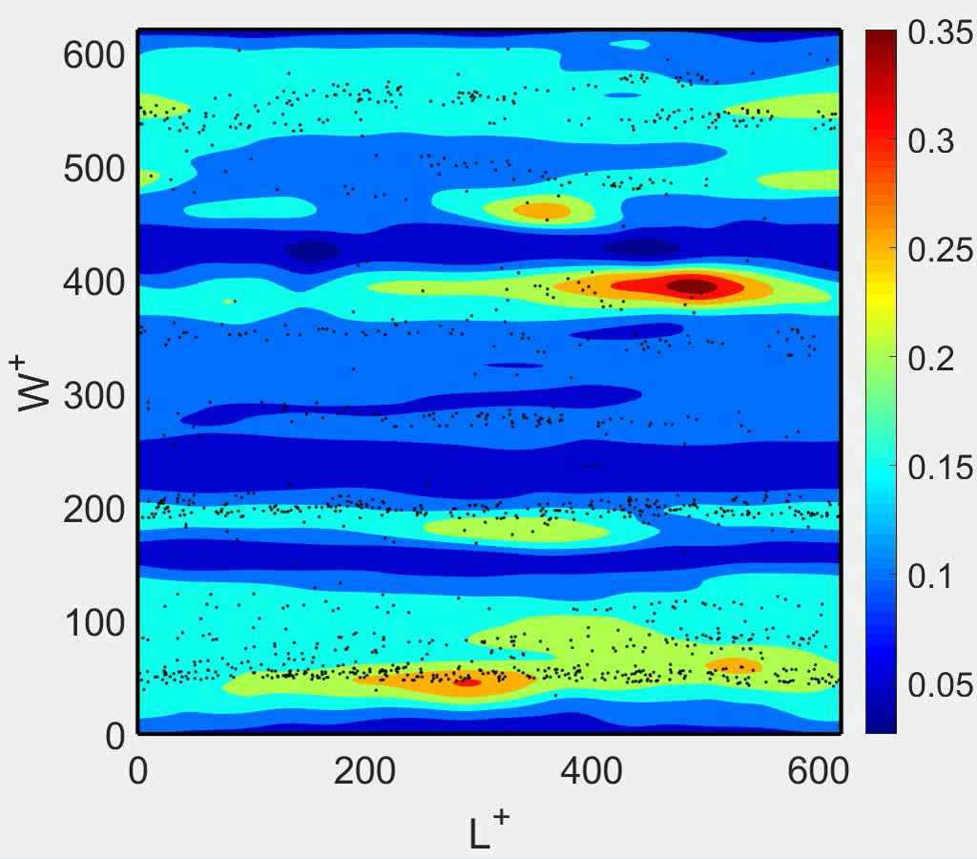
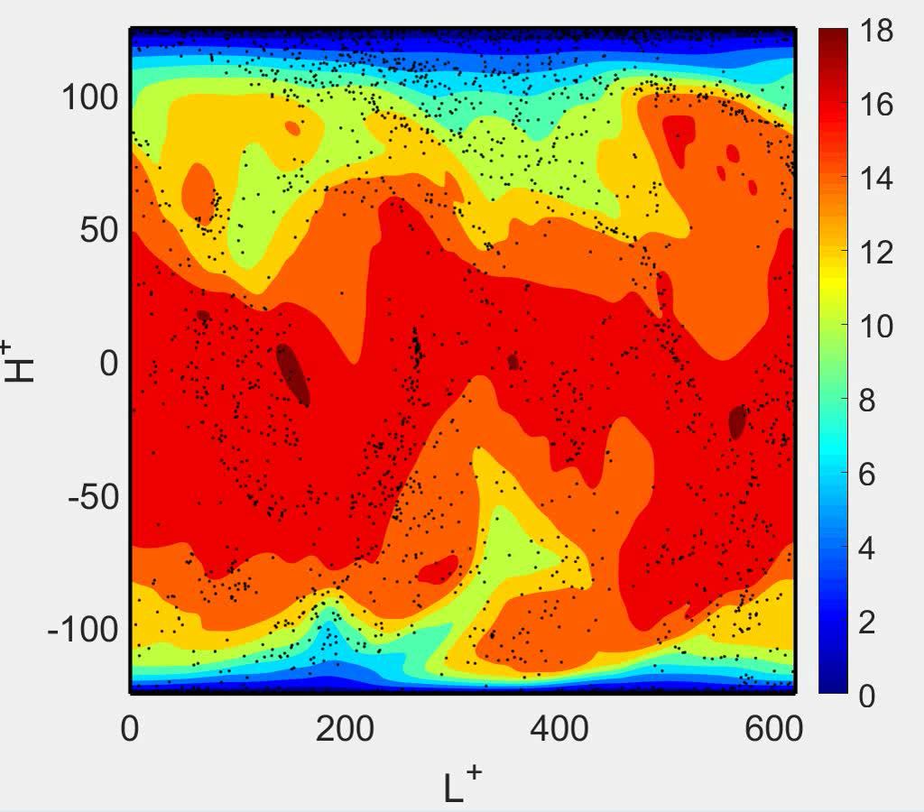
X-Velocity Contours of 30 µm
Normalwise direction
Spanwise direction

Slide 9
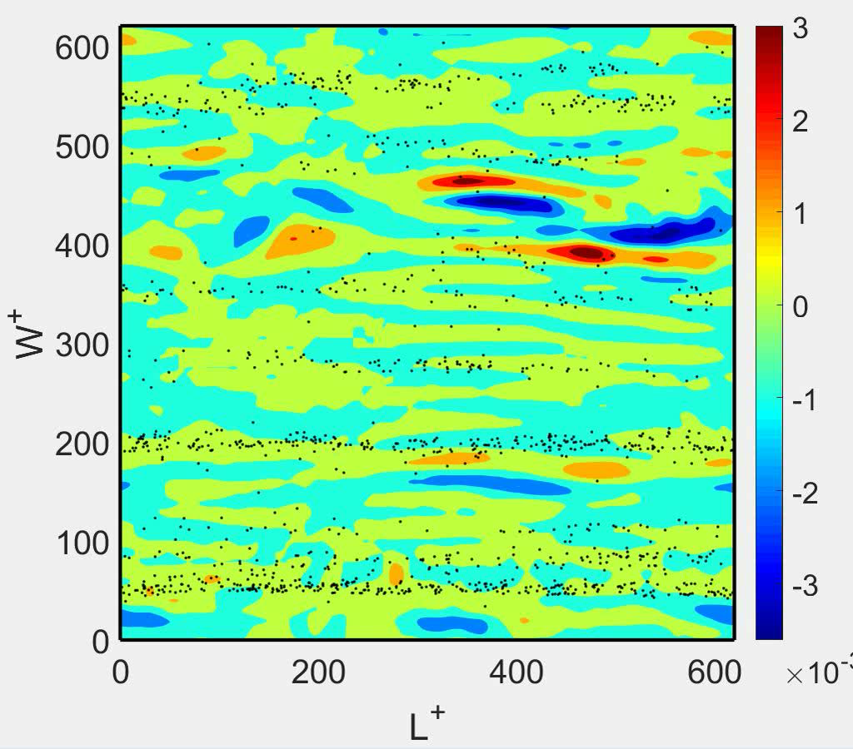
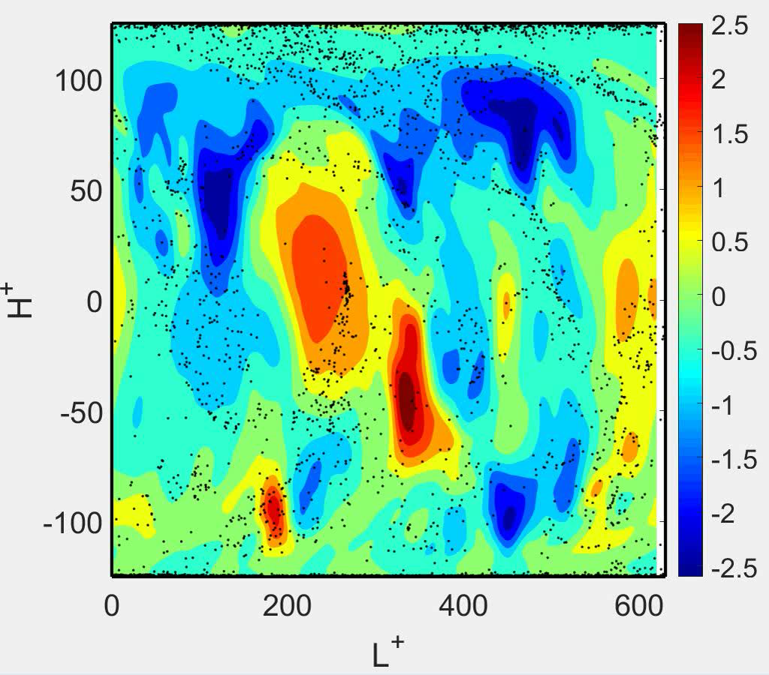
Y-Velocity Contours of 30 µm
Normalwise direction
Spanwise direction

Slide 10
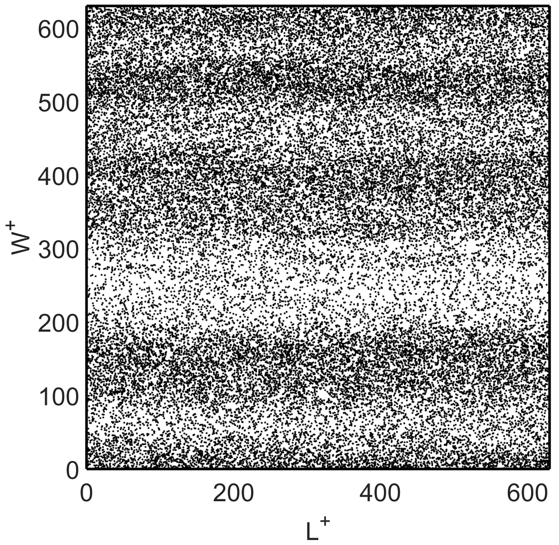
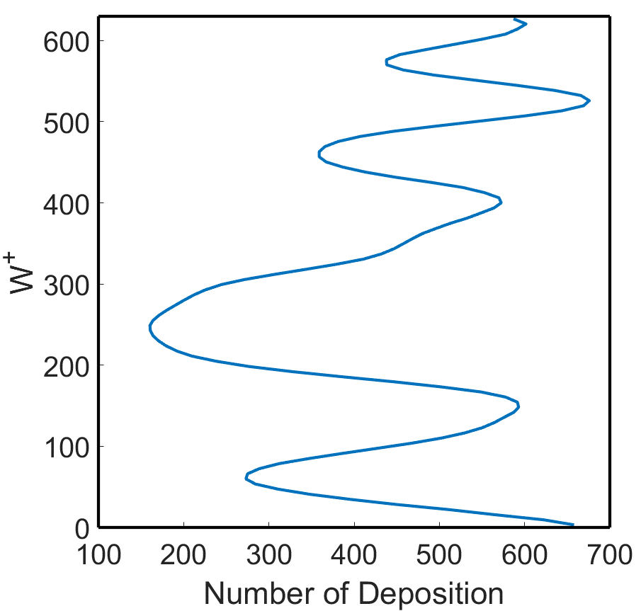
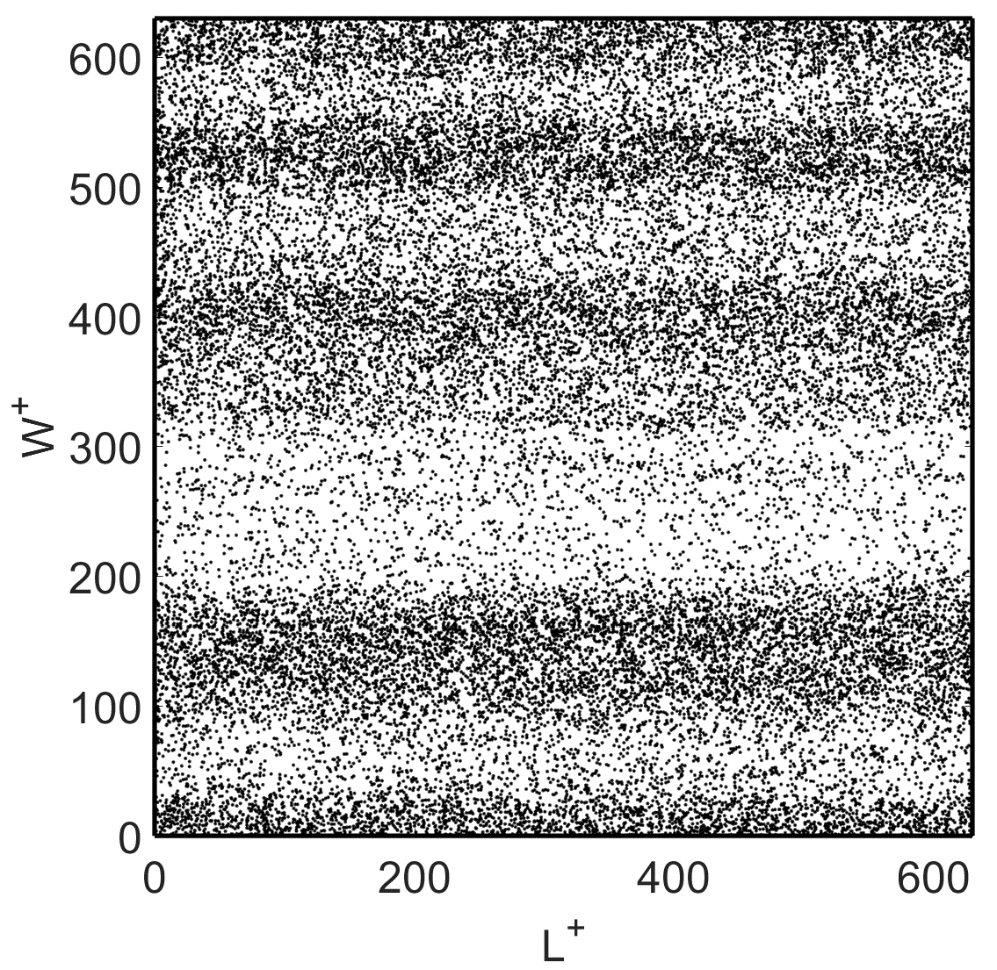
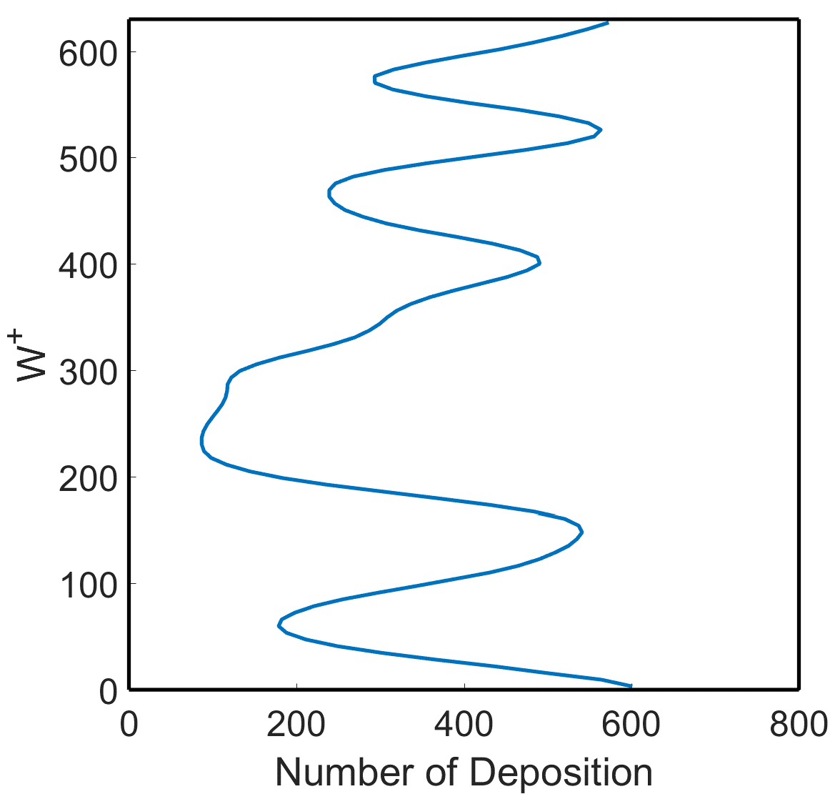
Pattern of Deposition on the Lower Wall
Dp=80 µm
Dp=60 µm

Slide 11
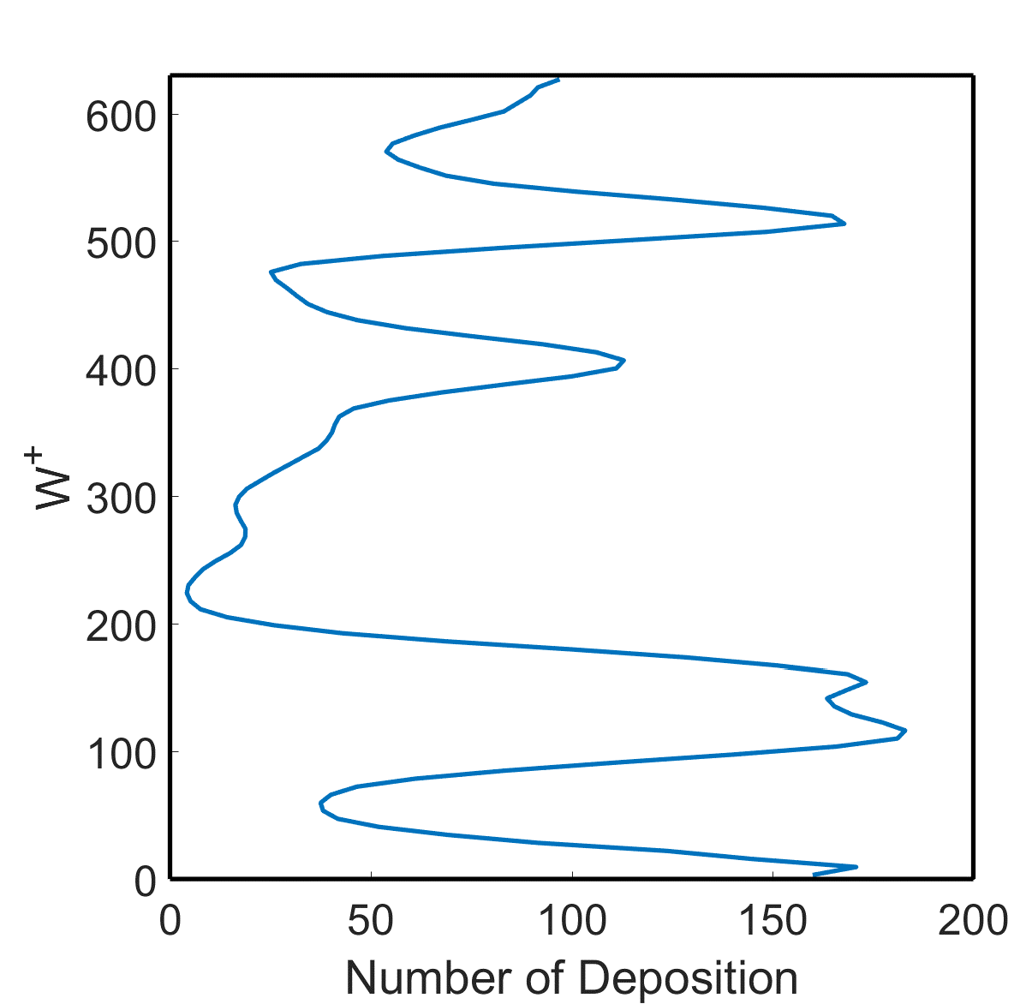
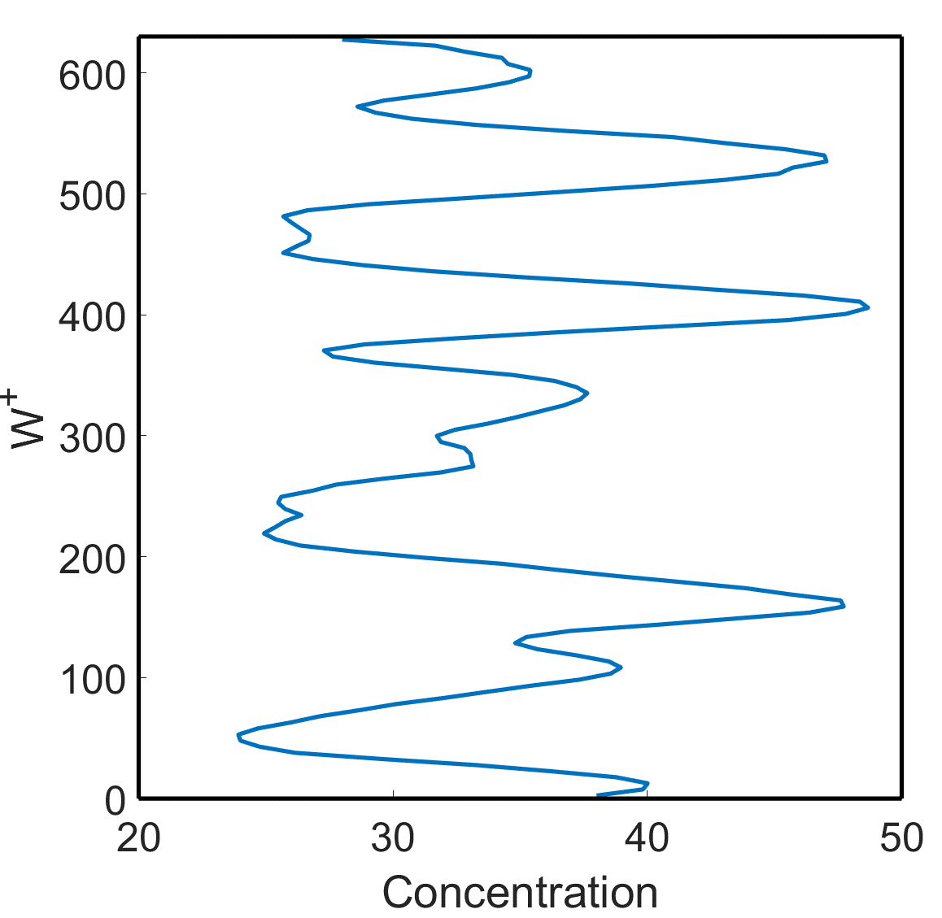
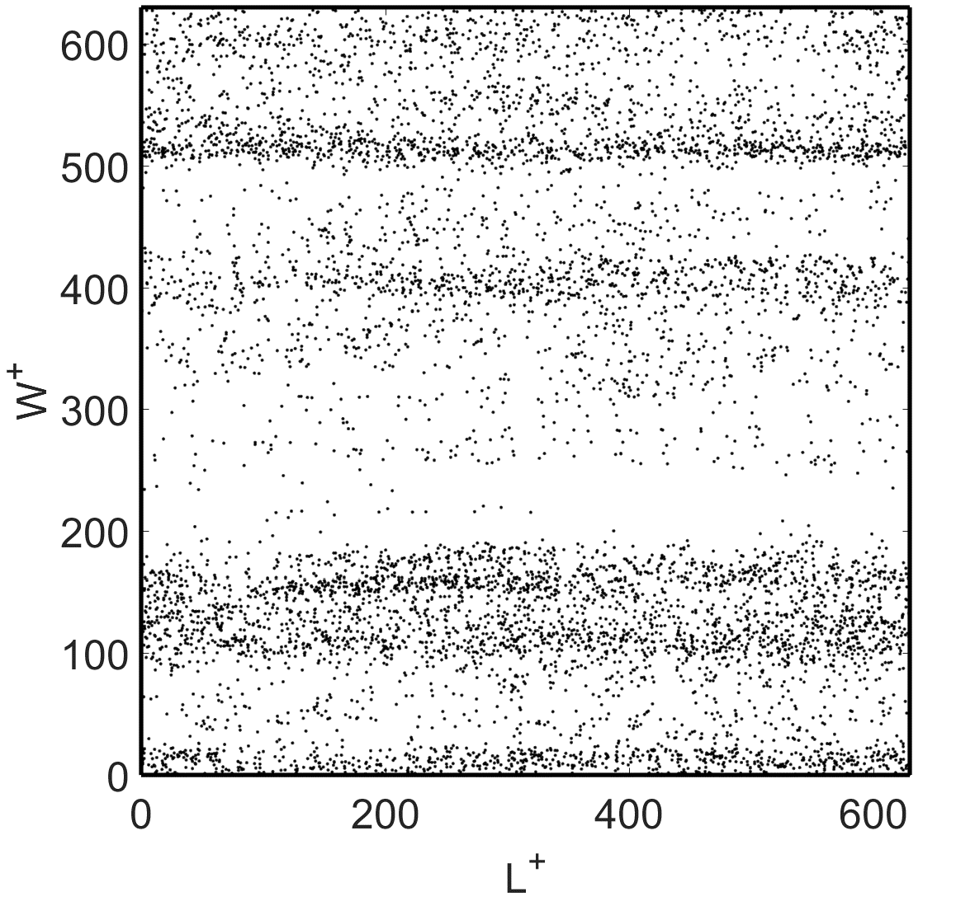
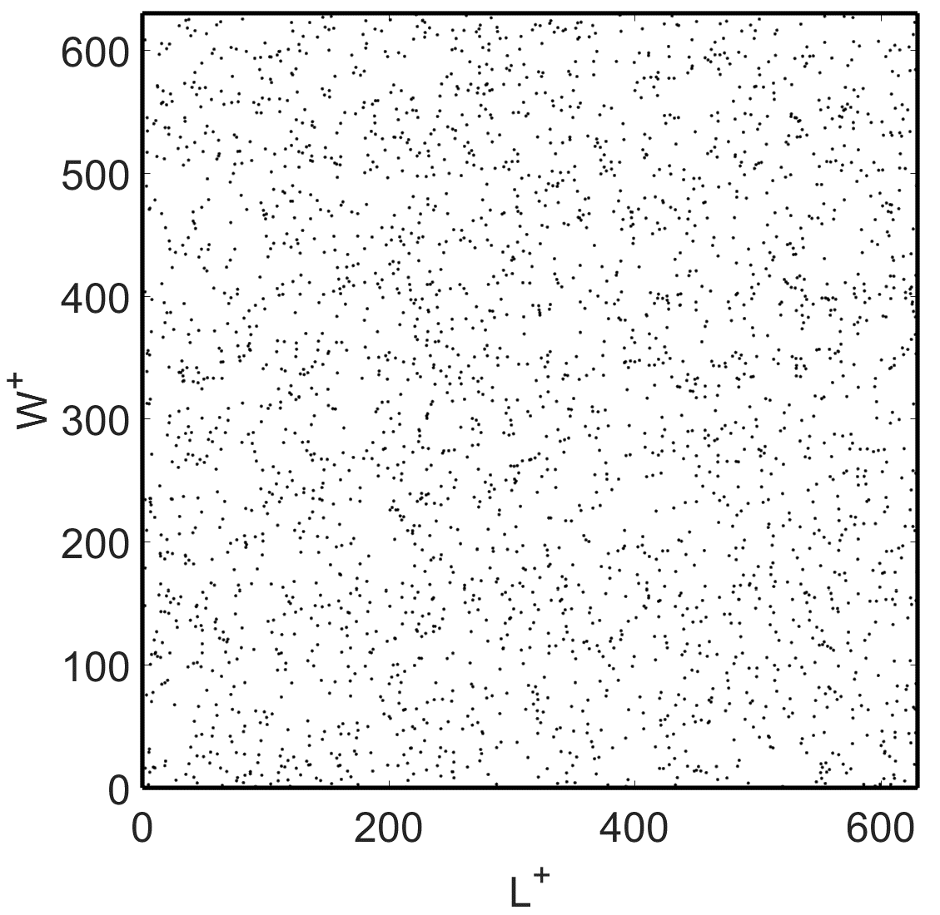
Pattern of Deposition on the Lower Wall
Dp=30 µm
Dp=10 nm

Slide 12
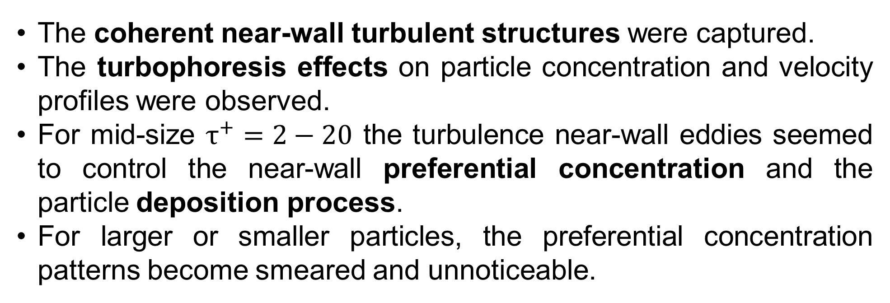
Conclusions
The coherent near-wall turbulent structures were captured.
The turbophoresis effects on particle concentration and velocity profiles were observed.
For mid-size $τ^{+}=2−20$ the turbulence near-wall eddies seemed to control the near-wall preferential concentration and the particle deposition process.
For larger or smaller particles, the preferential concentration patterns become smeared and unnoticeable.

Slide 13
Turbulent Flow Simulations
Direct Numerical Simulation (DNS)
All turbulent features are resolved
Computationally too demanding for industrial applications
Large Eddy Simulation (LES)
Subgrid-scale modeling needed
Computationally demanding (Less than DNS)
Reynolds Averaged Navier-Stokes (RANS)
Averaged velocities and turbulence features are evaluated
Used in industrial and environmental applications
Need a stochastic model to generate instantaneous fluctuations

Slide 14
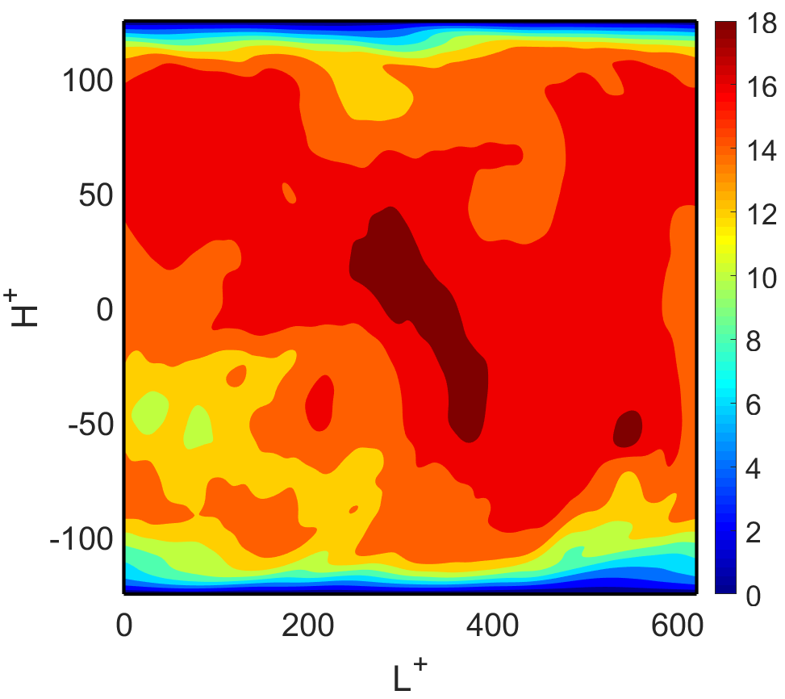
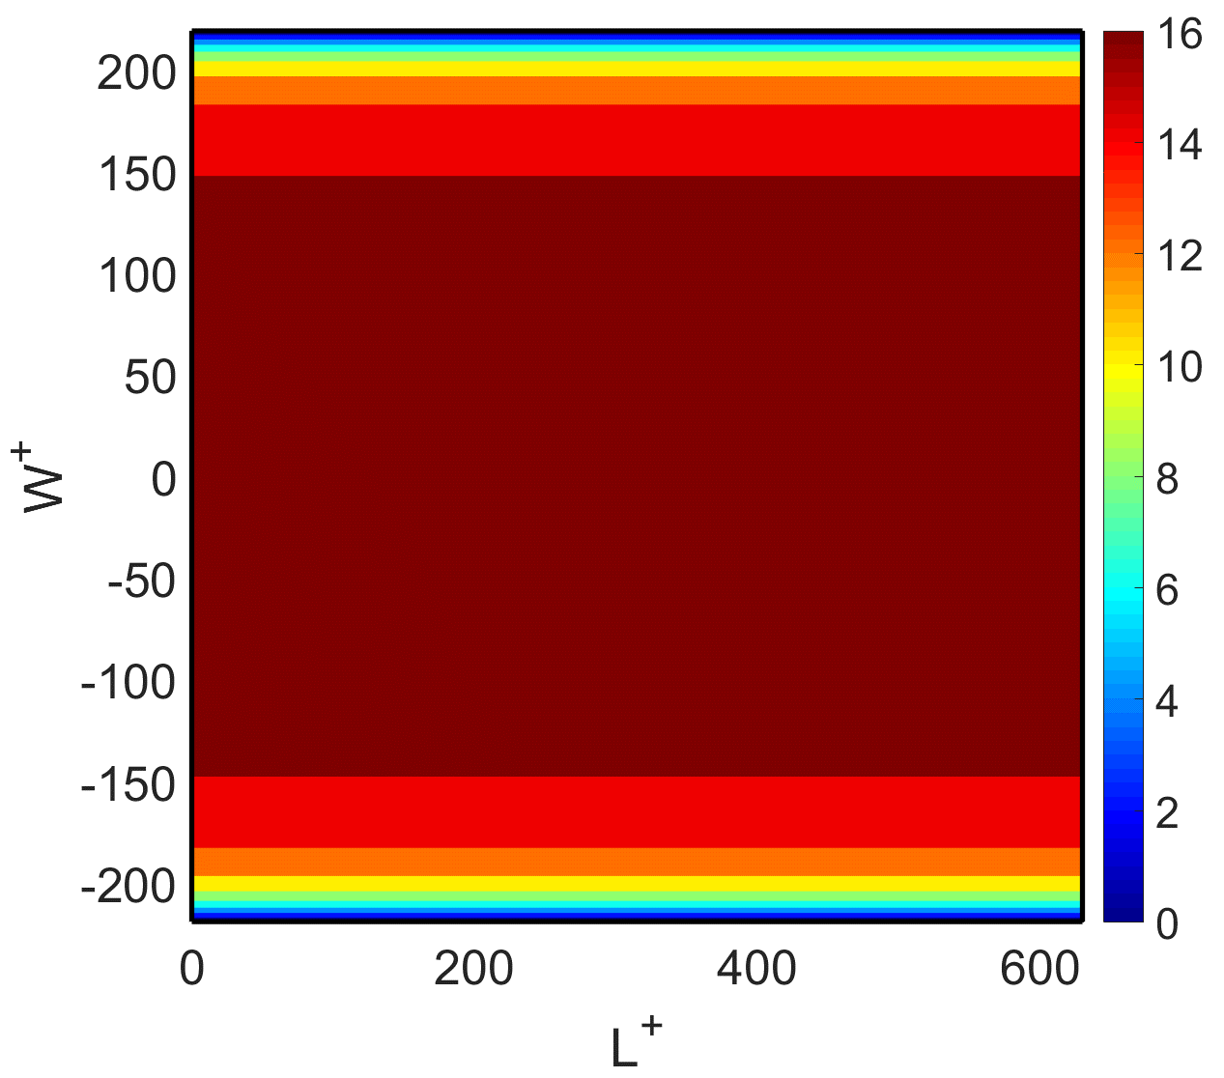
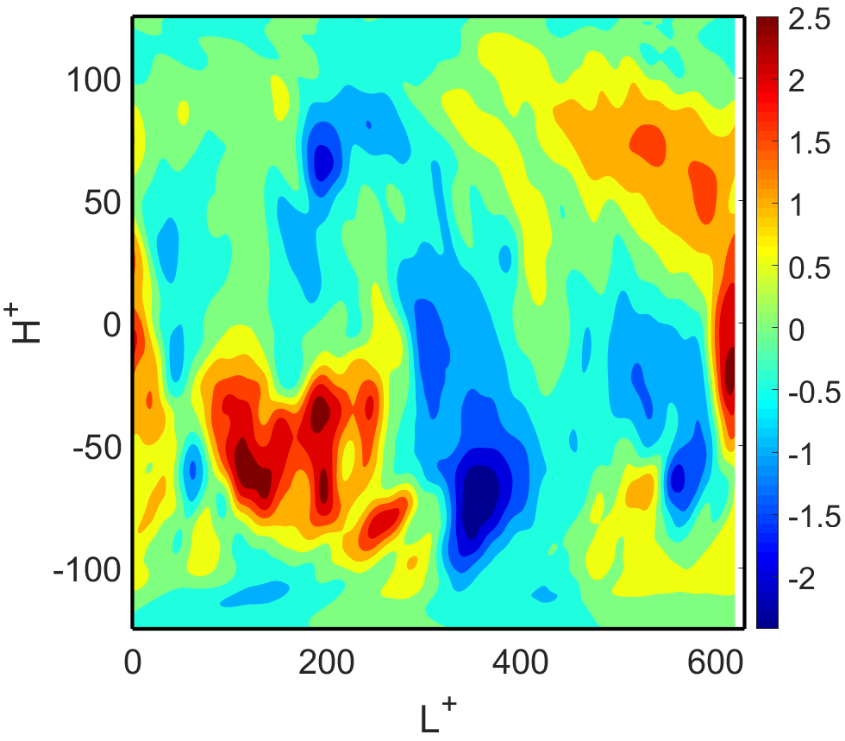
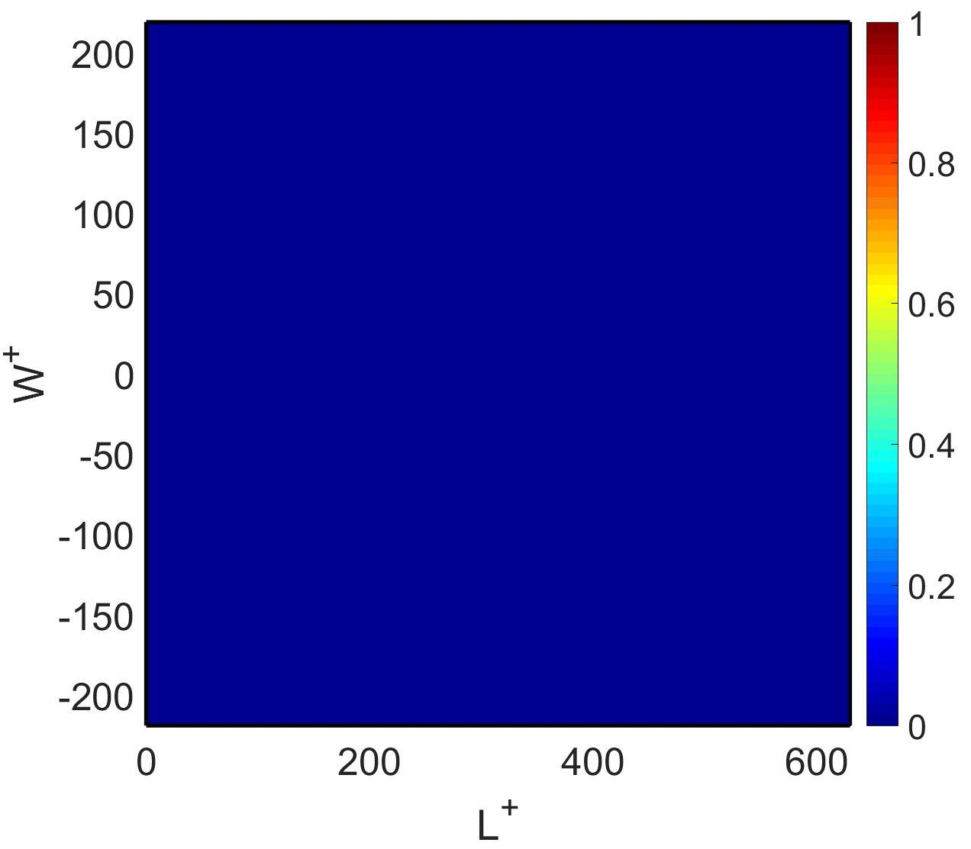
Velocity Contours
U Contours
DNS Results
RANS Results
V Contours

Slide 15
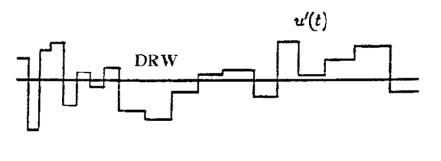
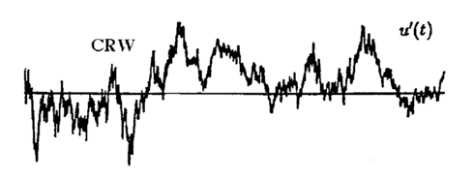
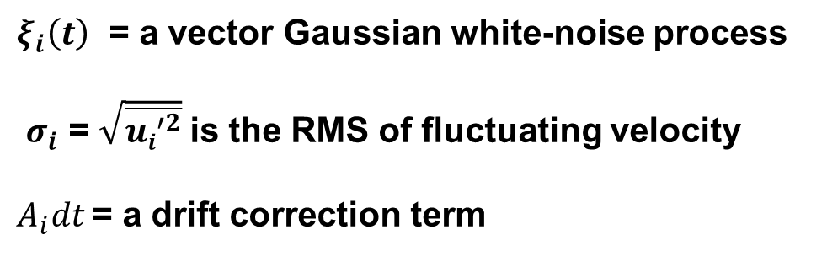
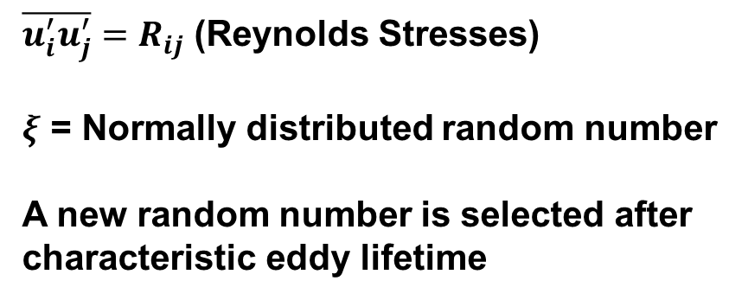
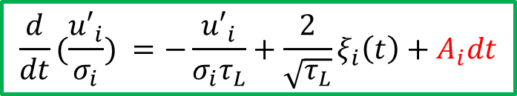
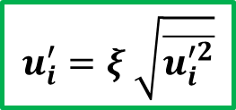
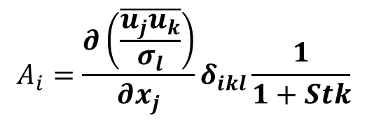
Stochastic Models
Discrete Random Walk (DRW) model:
Continuous Random Walk (CRW) model based on Langevin stochastic equation:
$$u_{i}^{′}=ξ \sqrt{\overline{u_{i}^{′2}}}$$
$$\frac{d}{dt}(\frac{{u′}_{i}}{σ_{i}}) =−\frac{{u′}_{i}}{{σ_{i}τ}_{L}}+\frac{2}{\sqrt{τ_{L}}}ξ_{i}\left(t\right)+A_{i}dt$$
$\overline{u_{i}^{′}u_{j}^{′}}=R_{ij}$ (Reynolds Stresses)
$ξ$ = Normally distributed random number
A new random number is selected after characteristic eddy lifetime
$ξ_{i}\left(t\right)$ = a vector Gaussian white-noise process
$σ_{i}$ = $\sqrt{\overline{{ui}^{′2}}}$is the RMS of fluctuating velocity
$A_{i}dt$ = a drift correction term
$$A_{i}=\frac{∂\left(\frac{\overline{u_{j}u_{k}}}{σ_{l}}\right)}{∂x_{j}}δ_{ikl}\frac{1}{1+Stk}$$
T. L. Bocksell and E. Loth, "Random walk models for particle diffusion in free-shear flows," AIAA journal, vol. 39, pp. 1086-1096, 2001.

Slide 16
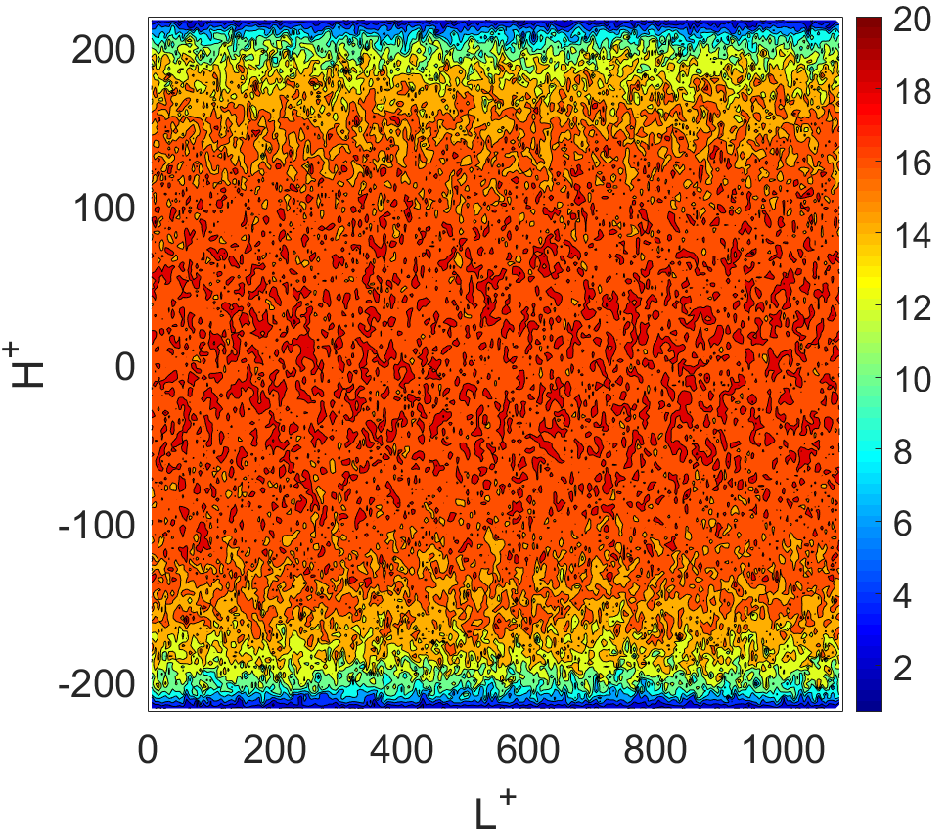
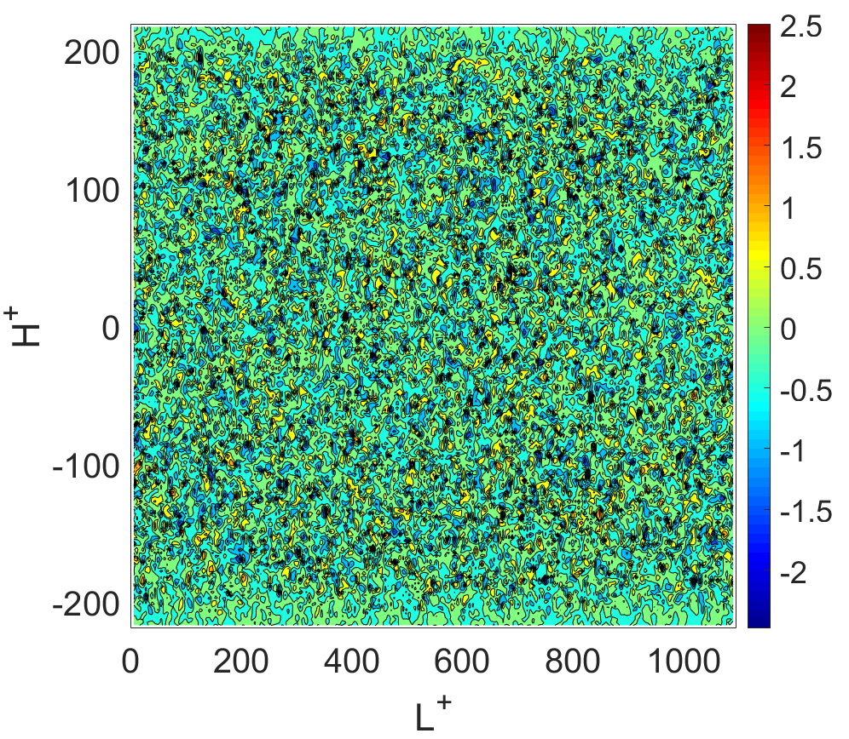
Generated Instantaneous Fluctuations

Slide 17
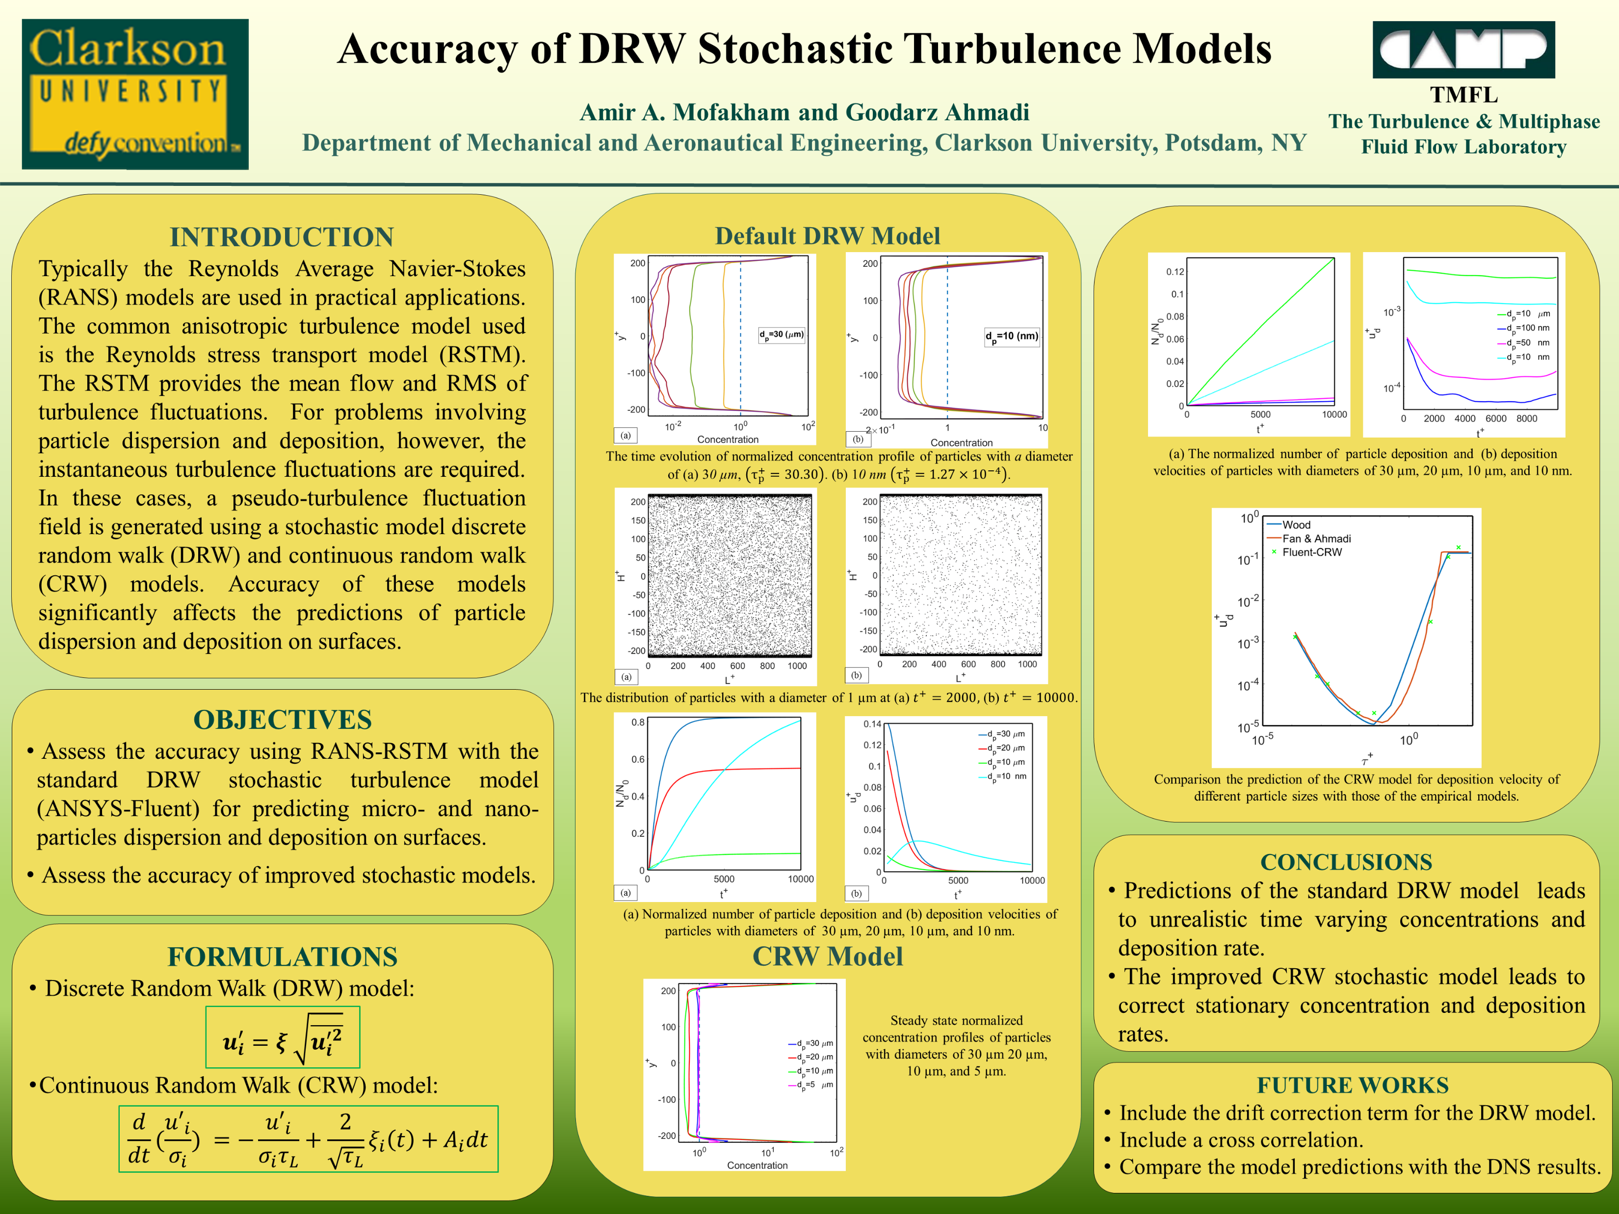

Slide 18
Future Works
Studying the Lagrangian and Eulerian time scale and their ratio for different size of particles.
Using the DNS data to propose a new turbulence stochastic model for RANS and LES simulations including:
Space correlations
Coherent near-wall structures

Slide 19

Questions

Slide 20
Coherent Wall Vortices

Slide 21
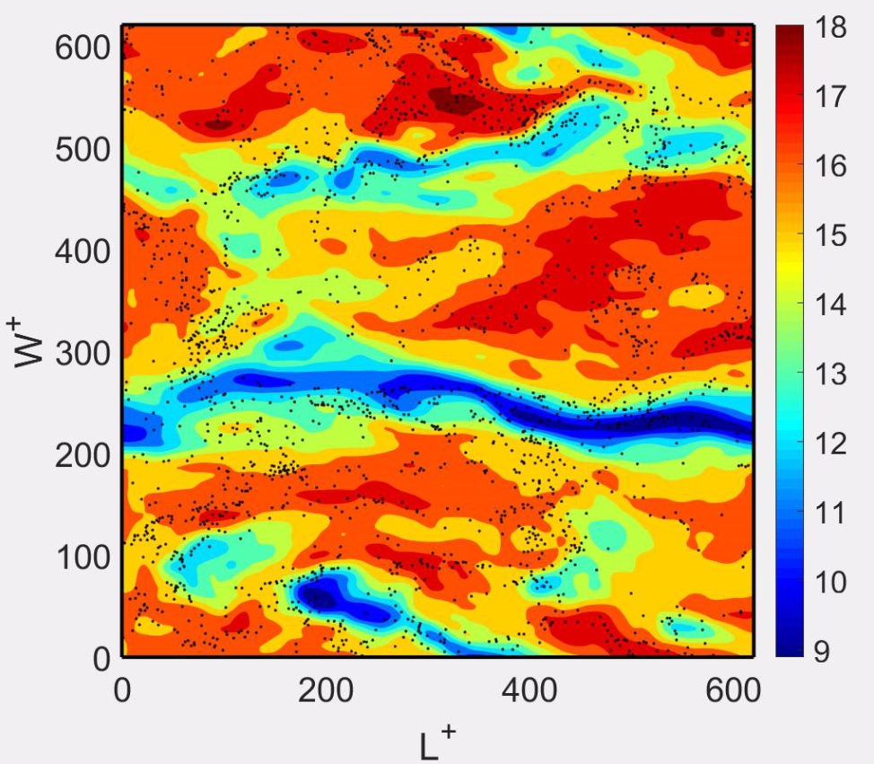
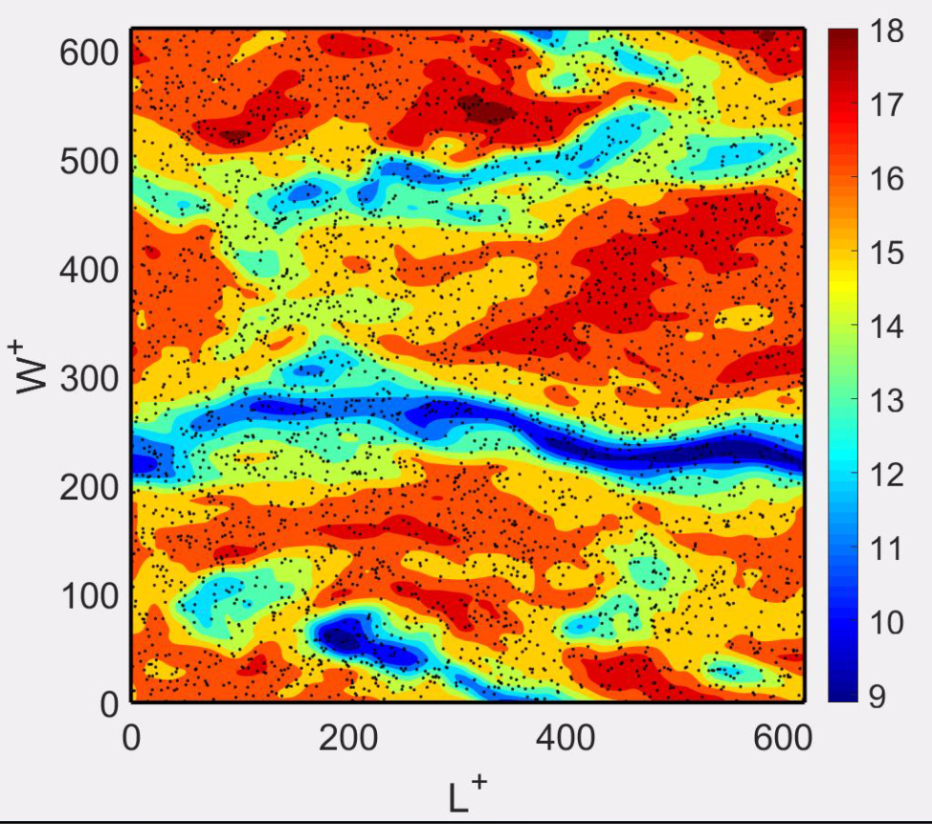
Comparison of Smaller Sizes
Dp=30 µm
Dp=10 nm

Slide 22
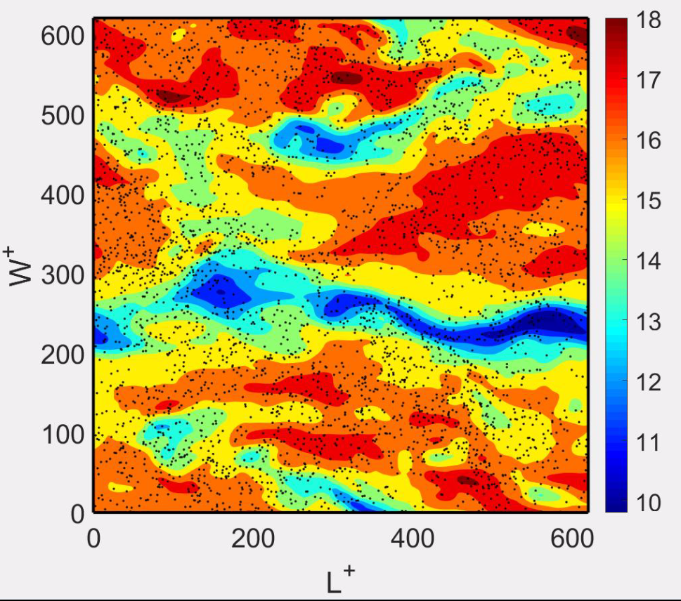
Comparison of Larger Sizes
Dp=30 µm
Dp=60 µm

Slide 23


Z-Velocity Contours of 30 µm
Normalwise direction
Spanwise direction

Slide 24
Outline
Introduction
Theory
Geometry and boundary condition
Governing equations
Results
RANS
Commercial software (ANSYS-Fluent)
In-house code
DNS
Summary and future works

